Slide 1
The Battle of White Plains
By: Anaiya Ardie and Carson Stark

Slide 2
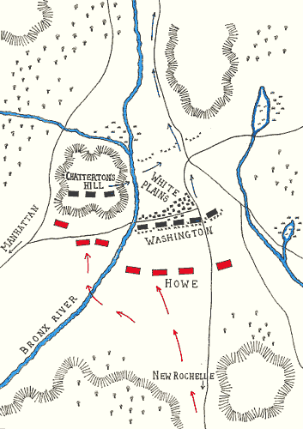
Location
White Plains, New York

Slide 3
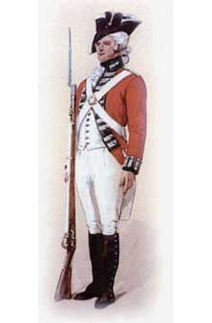
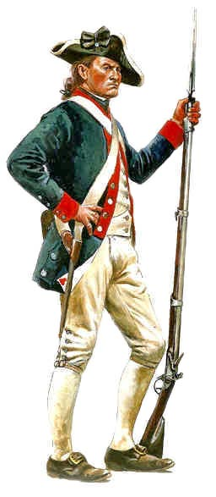
Troops There
Britain- 4,500
US- 1,600

Slide 4
Great Britain Casualties
my feet hurts
42 killed
182 wounded
3 captured

Slide 5
American Casualties
28 killed
126 wounded
16 captured

Slide 6
Who Won
The colonista colonists won.

Slide 7
Reference Page
www.theamericanrevolution.org
TAB: The Battle of White Plains

